Slide 1
Establishing Florida Residency
For In-State tuition

Slide 2
Why establish residency?
Florida residents pay a much lower tuition rate than non- residents for technical college training.
Florida law states that every applicant for admission to an institution of higher education shall be required to make a statement as to his or her length of residence in the state to be granted the in-state tuition rate.
Those who are unable to establish residency may enroll at a higher tuition rate.

Slide 3
What's the difference?
In-State
OUT-OF-STATE
Program | Cost
Automotive Service Technology | $6,135
Drafting | $4,657
Network Support Services | $3,318
Practical Nursing | $4,557
Program | Cost
Automotive Service Technology | $21.240
Drafting | $17,100
Network Support Services | $12,023
Practical Nursing | $15,525

Slide 4
Residing in Florida: What’s the difference?
Physical presence
Legal residence
Visiting on vacation
Expired Visa
Living with a friend or family member
Work full time
Driver’s license
Leasing/renting a home for one year or more
Home ownership

Slide 5
General guidelines
To get in-state tuition rates, students must meet a three-step (3) process:
Student must determine dependency status
Claimant must provide proof of citizenship/immigration status:
U.S. citizen
Foreign National in a non-immigrant visa classification that grants you the legal ability to establish a bona fide domicile in the United States
Permanent Resident alien,
Parolee, Asylee, Cuban-Haitian Entrant
Legal Alien granted indefinite stay by the U.S. Citizenship and Immigration Services
Other qualified alien as defined under federal law
Claimant must provide at least two documents of acceptable proof of residency in Florida of twelve (12) consecutive months before the start of class using the items listed on the residency affidavit.
Other persons not meeting the twelve-month legal residence requirements may be classified as Florida residents for tuition purposes only if they fall within one of the limited special categories (‘Qualification by Exception’) authorized by the Florida Legislature pursuant to section 1009.21, Florida Statutes. All other persons are ineligible for classification as a Florida “resident for tuition purposes.”
Students who attend school on a Foreign Student Visa must pay out-of-state tuition rates.

Slide 6
Proving Florida residency: 3 steps
Step 1:
Dependency Status
Step 2:
Proof of Citizenship/Lawful Immigration Status
Step 3:
Documentation of Florida Residency

Slide 7
Step 1: Student Dependency status
Students must select one status. Dependency status will determine who will submit documentation for at least twelve (12) consecutive months of Florida residency to qualify for in-state tuition.
❑ I am a dependent student
❑ I am an independent person
❑ I meet residency requirements through one of the Qualifications by Exception

Slide 8
Dependency status: Dependent student
I am eligible to be claimed as a dependent under the federal income tax code by the claimant. The claimant is my “parent” as defined by s. 1009.21(1)(f), Florida Statutes, (i.e., either or both parents of the student, any guardian of a student, or any person in a parental relationship to the student). My parent has maintained legal residence in Florida for a least the past 12 consecutive months. A copy of your parent’s tax return may be requested to establish dependence.

Slide 9
Dependency status: Dependent student
Examples of Qualifying child or dependent:
Under age 24
No children
Not married
Was claimed on claimant taxes
Child must have lived with claimant for more than half the year and must not have provided more than half of his/her own support for that year

Slide 10
Dependency Status: Independent student
I provide more than 50% of my own support. An independent student generally includes a person who is at least 24 years old, married, a graduate or professional student, a veteran, a member of the armed forces, a ward of the court, or someone with legal dependents other than a spouse. There may be limited cases where a person under the age of 24 years old may qualify as an independent student. Such students will be required to verify independence (including financial independence.) A copy of your tax return may be requested to establish independence.

Slide 11
Dependency Status: Independent student
Example of Independent Students:
24 years of age or older
Married
Has children
Veteran of the US Armed Forces
At any time since the student turned age 13, where parents are deceased, or the student is or was (until age 18) one of the following:
a ward/dependent of the court or
in foster care

Slide 12
Dependency status: Qualification by Exception
As provided in s. 1009.21, Florida Statutes, I qualify for residency based on one of the following permitted exception (documentation required):
I am a qualified beneficiary under the terms of the Florida Prepaid College Program.
I am married to a person who has maintained legal residence in Florida for at least the past 12 consecutive months.
I was previously enrolled at a Florida state postsecondary institution and classified as a Florida resident for tuition purposes within the past 12 months.

Slide 13
Dependency status: Qualification by Exception
As provided in s. 1009.21, Florida Statutes, I qualify for residency based on one of the following permitted exception (documentation required):
I was previously enrolled at a Florida state postsecondary institution and classified as a Florida resident for tuition purposes. I abandoned my Florida domicile less than 12 months ago and am now re-establishing Florida legal residence.
Active duty members of the Armed Services of the United States.
United States citizens living on the Isthmus of Panama, who have completed 12 consecutive months of college work at the Florida State University Panama Canal Branch, and their spouses and dependent children.

Slide 14
Qualification by exception, Cont.
Full-time instructional and administrative personnel employed by state public schools and institutions of higher education and their spouses and dependent children.
Students from Latin America and the Caribbean who receive scholarships from the federal or state government. Any student classified pursuant to this paragraph shall attend, on a full-time basis, a Florida institution or higher education.
Southern Regional Education Board’s Academic Common Market graduate students attending Florida’s state universities.
Full-time employees of state agencies or political subdivisions of the state when the student fees are paid by the state agency or political subdivision for the purpose of job-related law enforcement or corrections training.

Slide 15
Qualification by exception, Cont.
McKnight Doctoral Fellows and Finalists who are United States citizens.
United States citizens living outside the United States who are teaching at a Department of Defense Dependent School or in an American International School and who enroll in a graduate level education program which leads to a Florida teaching certificate.
Active duty members of the Canadian military residing or stationed in this state under the North American Air Defense (NORAD) agreement, and their spouses and dependent children, attending a Florida College System institution or state university within 50 miles of the military establishment where they are stationed.
Active duty members of a foreign nation’s military who are serving as liaison officers and are residing or stationed in this state, and their spouses and dependent children, attending a Florida College System institution or state university within 50 miles of the military establishment where the foreign liaison officer is stationed.

Slide 16
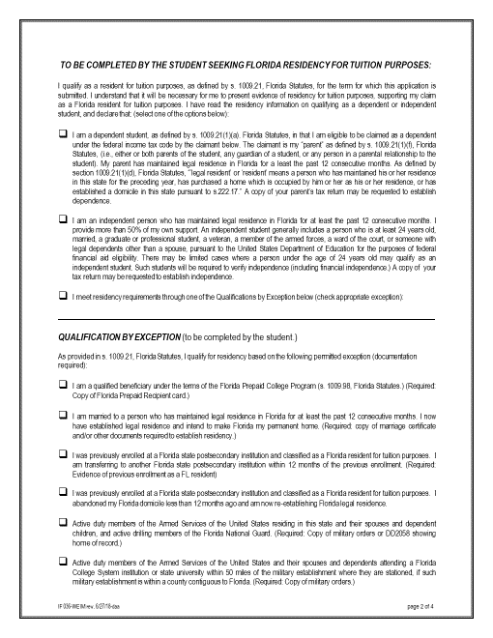
Select ONE of the three
If you selected ‘Qualification by Exception’ you must also choose one exception from the list on page 2 or page 3. Copy of exception document must be provided.

Slide 17
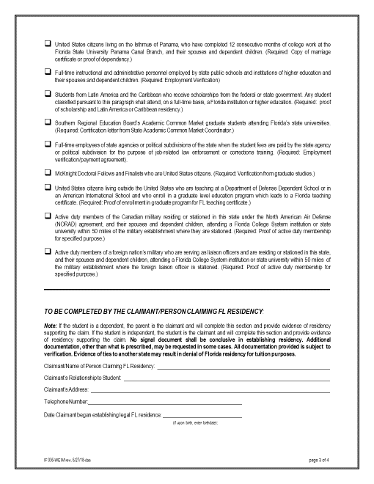
Claimant = Parent of Dependent Student
Claimant = Student if Independent Student
Claimant = Spouse if Qualification Exception is by marriage
Enter Claimant Information

Slide 18
Proving Florida residency: 3 steps
Step 1:
Dependency Status
Step 2:
Proof of Citizenship/Lawful Status
Step 3:
Documentation of Florida Residency

Slide 19
Confidentiality
All information shared regarding citizenship status is confidential and only used for the purpose of determining qualification for in-state tuition rates

Slide 20
Step 2: Citizenship/Lawful immigration status
Non-U.S. citizen students and/or their parent(s)/guardian must provide evidence of eligible lawful immigration status in the U.S. before they may be considered for Florida resident fees. NOTE: your dated documents must be valid through the length of your enrollment
Eligible to prove residency
US Citizen: born or naturalized
Eligible Non-citizen:
Foreign national in a non-immigrant visa classifications that grant the legal ability to establish a bona fide domicile in the US: A, E, G, H-1B, H-1C, I, K, L, N, NATO 1-7, O-1, R, S, T, U, and V.
Permanent resident alien
Parolee or Withholding of Deportation
Asylee or Applications for Asylum
Cuban-Haitian entrant
Other legal alien granted indefinite stay by IMS, or other qualified alien as defined under federal law, etc.

Slide 21
Step 2: Citizenship/Lawful immigration status
Not Eligible to prove residency
Ineligible Non-Citizen:
F1 or F2 Visa
J1 or J2 exchange visitor visa
G series visa
Expired visa
No lawful immigration status
Status will expire before end of career training program and not renewable

Slide 22
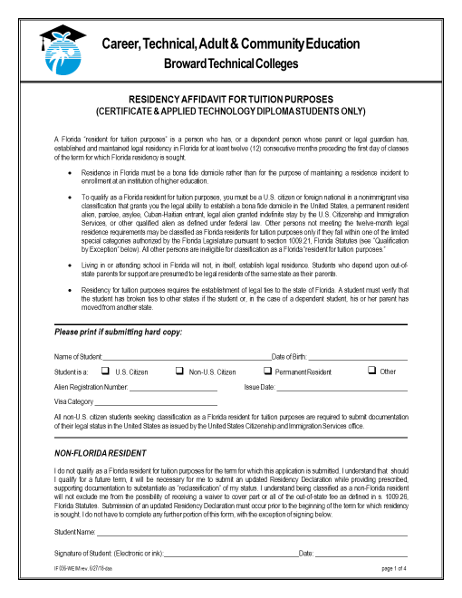
Students seeking Florida Residency must enter name, date of birth, and select a citizenship status. Non-US citizen must provide copy of status. No other information should be entered on this page.
Name, date, and Signature required ONLY for Students who cannot seek Florida in-state tuition. STOP: No other information should be entered on this page or any other pages since you cannot prove residency.

Slide 23
Proving Florida residency: 3 steps
Step 1:
Dependency Status
Step 2:
Proof of Citizenship/Lawful Status
Step 3:
Documentation of Florida Residency

Slide 24
Step 3: Documented evidence
All documents supporting the establishment of Florida residency for tuition classification purposes must:
Be original and unaltered, as well as dated, issued, or filed twelve (12) months before the first day of the term in which the Florida residency-for-tuition-purposes classification is requested.
Show that all names listed on each of the documents match.
Must be written or electronic verification that includes two or more of the documents specified in the residency affidavit. No single piece of evidence shall be conclusive.

Slide 25
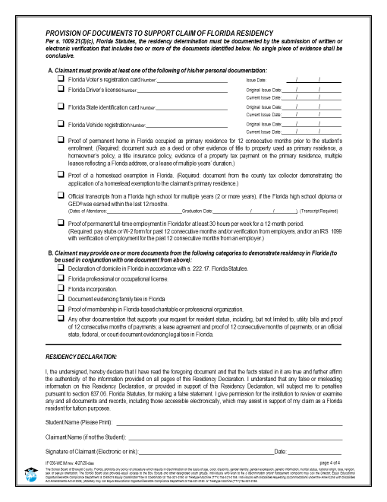
Select documents that will be provided by claimant.
Dependent Student: parent documents
Independent Student: self
Qualification Exception by marriage: spouse documents
Select two from Category A
or
Select one from Category A and one from Category B
Claimant must sign form

Slide 26
Documented Evidence: Category A
Must include at least one
a. A Florida voter’s registration card.
b. A Florida driver license.
c. A State of Florida identification card.
d. A Florida vehicle registration.
e. Proof of a permanent home in Florida which is occupied as a primary residence by the individual or by the individual’s parent if the individual is a dependent child.
f. Proof of a homestead exemption in Florida.
g. Transcripts from a Florida high school for multiple years if the Florida high school diploma or high school equivalency diploma was earned within the last 12 months.
h. Proof of permanent full-time employment in Florida for at least 30 hours per week for a 12-month period.

Slide 27
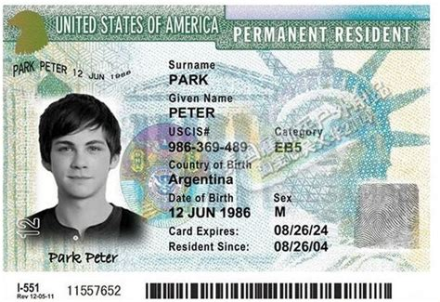
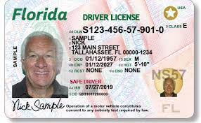
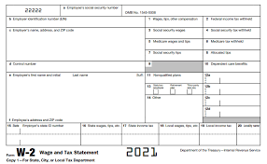
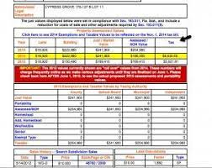
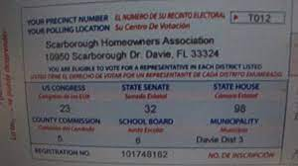
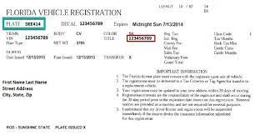
Acceptable Document samples

Slide 28
Documented Evidence: Category b
May include one or more
a. A declaration of domicile in Florida.
b. A Florida professional or occupational license.
c. Florida incorporation.
d. A document evidencing family ties in Florida.
e. Proof of membership in a Florida-based charitable or professional organization.
f. Any other documentation that supports the student’s request for resident status, including, but not limited to, utility bills and proof of 12 consecutive months of payments; a lease agreement and proof of 12 consecutive months of payments; or an official state, federal, or court document evidencing legal ties to Florida.

Slide 29
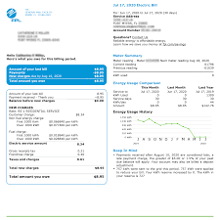
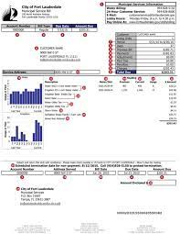
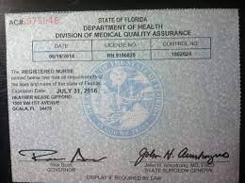
Acceptable Document samples

Slide 30
Unacceptable documents
The documents below cannot be used to support Florida residency classification for tuition purposes
Hunting/fishing licenses
Library cards
Birth Certificate
Passport
Social security card
Shopping club/rental cards
Insurance card
Bank statement
Mobile telephone bill
Immigration paperwork

Slide 31
am I eligible for in-state tuition?
Yes, if you meet any of the following
You are a US Citizen or eligible lawful non-Citizen, and you have the required legal documentation showing 12 months of residency in Florida prior to enrollment
You are a dependent person, and your parent has the required legal documentation showing 12 months of residency in Florida prior to enrollment
You are an independent person (I support myself or I’m over 24 yrs. old or married) and has the required legal documentation showing 12 months of residency in Florida prior to enrollment
You have legal ties to the state of Florida and the required documentation showing that

Slide 32
am I eligible for in-state tuition?
No, if you meet any of the following
You are not a US Citizen or eligible lawful non-Citizen
You are dependent person and your parent lives outside of Florida
You or the claimant does not have the required documentation
You’re an international student
You’re on an M-1 student visa
You were previously enrolled in a Florida state postsecondary institution with Florida Residency classification more than 12 months ago.

Slide 33
Proving Florida residency: 3 steps
Step 1:
Dependency Status
Step 2:
Proof of Citizenship/Lawful Status
Step 3:
Documentation of Florida Residency

Slide 34
Example
Student is 21 years old. Permanent Resident. Has Florida driver’s license. Owns a home. Parent is permanent resident and owns a home in Florida but works for UN in Haiti. Parent claims 21-year-old as dependent on taxes filed in Florida.
Student = dependent
Claimant = parent
Proof of Lawful Immigration status = adequate from parent
Proof of Florida Residency = adequate from parent
If all documents provided, student would qualify for in-state tuition based on parent’s information.

Slide 35
example
Student is 25 years old and has TPS status issued in May 2022. Class starts August 2022. Driver’s license issued August 2021. Leasing apartment since January 2022.
Student = Independent
Claimant = student
Proof of lawful immigration status = adequate
Proof of Florida Residency = not acceptable
Student would not qualify for in-state tuition because all documents to prove Florida Residency must be dated 12 months after receiving TPS status.

Slide 36
examples
Student is married to a US Citizen or someone with a Permanent Resident card. Student just moved to Florida in May 2022. Class starts in August 2022. Spouse can provide proof of lawful immigration status. Spouse has lived in Florida since January 2019 with driver’s license and vehicle registration.
Student = Qualification by Exception: married to a person who has legal residence in FL for at least 12 consecutive months. Copy of marriage license required.
Claimant = Spouse
Proof of lawful immigration status = adequate from spouse
Proof of Florida residency = adequate from spouse
If all documents provided, student would qualify for in-state tuition based on Spouse’s information.

Slide 37
Summary of Establishing florida residency
Know your dependency status so you are clear who will be the claimant
The claimant must provide proof of lawful immigration status by providing the right documents
The claimant who provides adequate proof of lawful immigration status can now provide documents to prove that they have resided in the State of Florida for 12 consecutive (back-to-back) months
Pay Florida In-State Tuition Rate

Slide 38
Things to know about Florida residency for tuition purposes
Your non-US citizenship status may differ from others. Please make an appointment to meet with a counselor to discuss your individual situation.
There is an appeals process if you disagree with a denial of your request.
You can ask to be re-evaluated for future semesters if you now have evidence.
Those under 24 years of age receiving in-state tuition as an Independent will still need their parental information if applying for Financial Aid.

Slide 39
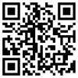
Questions?
Please contact a program counselor with individualized questions in the
ATC Office of Student Affairs:
Main campus: building 10
Arthur Ashe, Jr. campus: building 2
Office of Student Affairs
Main campus: 754-321-5200
Arthur Ashe, Jr. campus: 754-322-2800
Appointment system: https://kiosk.na6.qless.com/kiosk/app/home/16

